Slide 1
Small but Mighty: Case Studies from Smaller ORCID Consortia.
Chieh-chih Estelle Cheng 鄭潔之
Engagement Manager Global Direct
https://orcid.org/0000-0002-3207-0527
Advancing ORCID Adoption in the Research Landscape : Practical Pathways for Identity, Integration, and Impact 20250807

Slide 2
Outline
The diversity of ORCID Consortia
ORCID in Taiwan
Case studies of smaller consortia
Discussion and Feedback
Notes:
O

Slide 3

We currently have 30 ORCID Consortia around the world
https://info.orcid.org/orcid-for-consortia/
Americas | Europe |  | Middle East & Africa
Brazil 🇧🇷 | Austria 🇦🇹 | Italy 🇮🇹 | Israel 🇮🇱
Canada 🇨🇦 | Belgium 🇧🇪 | Latvia 🇱🇻 | Lebanon 🇱🇧
Chile 🇨🇱 | Czech Republic 🇨🇿 | Netherlands 🇳🇱 | Nigeria 🇳🇬
LATAM Regional Consortium: Colombia 🇨🇴 México 🇲🇽 Costa Rica 🇨🇷 Panamá 🇵🇦 El Salvador 🇸🇻 Perú 🇵🇪 Ecuador 🇪🇨 | Denmark 🇩🇰 | Norway 🇳🇴 | South Africa 🇿🇦
 | Finland 🇫🇮 | Sweden 🇸🇪 | Uganda
 | France 🇫🇷 | Ukraine 🇺🇦 | Asia–Pacific
 | Germany 🇩🇪 | United Kingdom 🇬🇧 | Australia 🇦🇺
USA — Non Profits 🇺🇸 | Ireland 🇮🇪 |  | Japan 🇯🇵
USA — Government Agencies 🇺🇸 |  |  | New Zealand 🇳🇿
 |  |  | Taiwan 🇹🇼

Slide 4
Every Consortium is different
Category | Data Point | Notes
Consortia Models | Mixed | Library-led, funder-led, government-led,NREN-led and hybrid structures
Member Organizations | 1,432+ | Includes universities, funders, publishers, and research institutes
Languages Supported | 12+ | Including English, Spanish, Japanese, Portuguese, and Arabic
Staff (FTE) | 0.25 - 3 | Supporting global operations, tech, and outreach

Slide 5
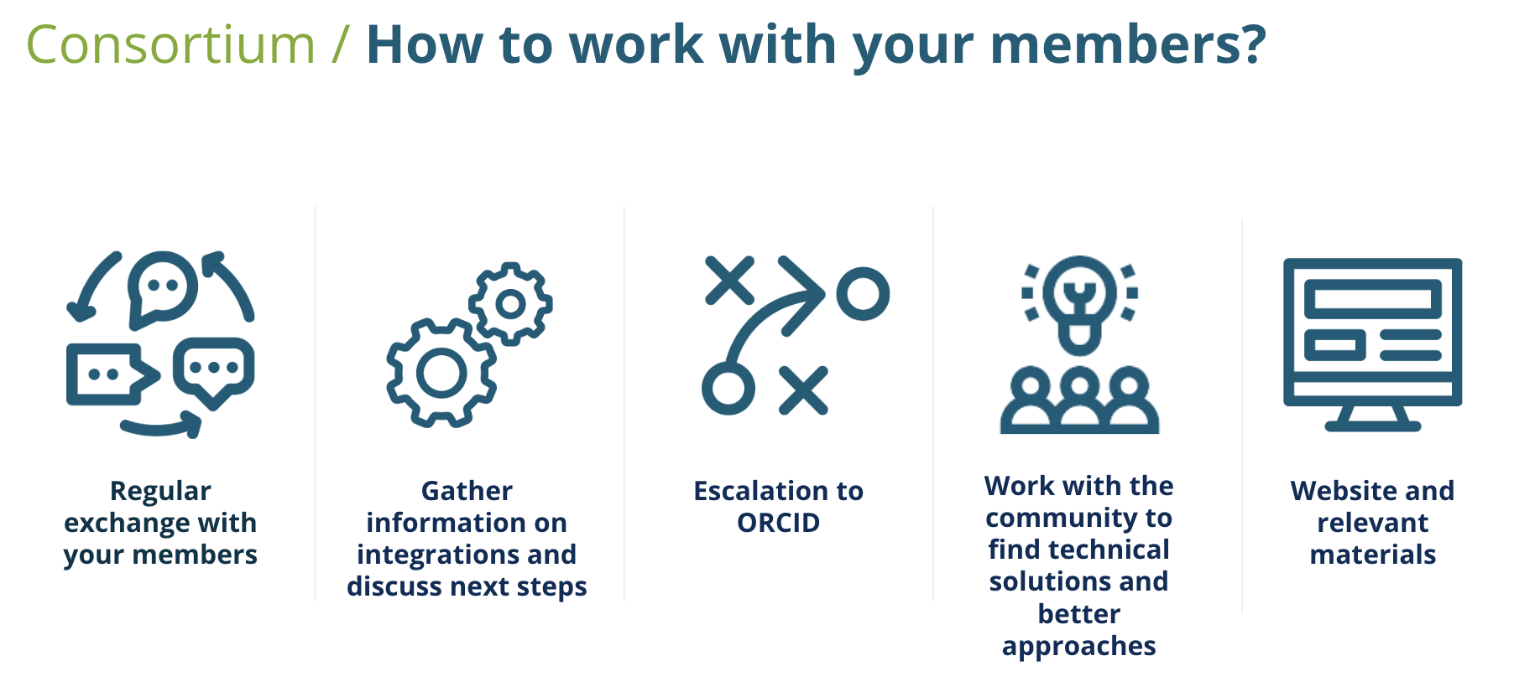
Yet following the guidelines all can build a successful consortium!

Slide 6
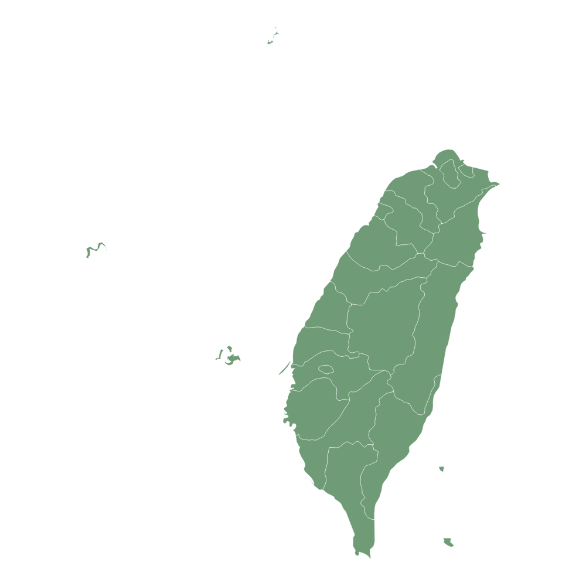
The current adoption in Taiwan
8 member organisations
  5 of these led by NYCU
11 integrations from all 8 members
61.13K researchers with affiliations and professional activities associated with Taiwan
106.27K affiliations and professional activities
*Affiliations: An affiliation is a relationship between a person and an organization, linking the two, including Employment and Education
*Professional activities: information about your membership affiliation with an organization, your activities in service of an organization, invited positions and distinctions, qualification, Invited positions etc.
8
MEMBERS
Data collected on the 2023
Notes:
The integration status in Japan

Slide 7
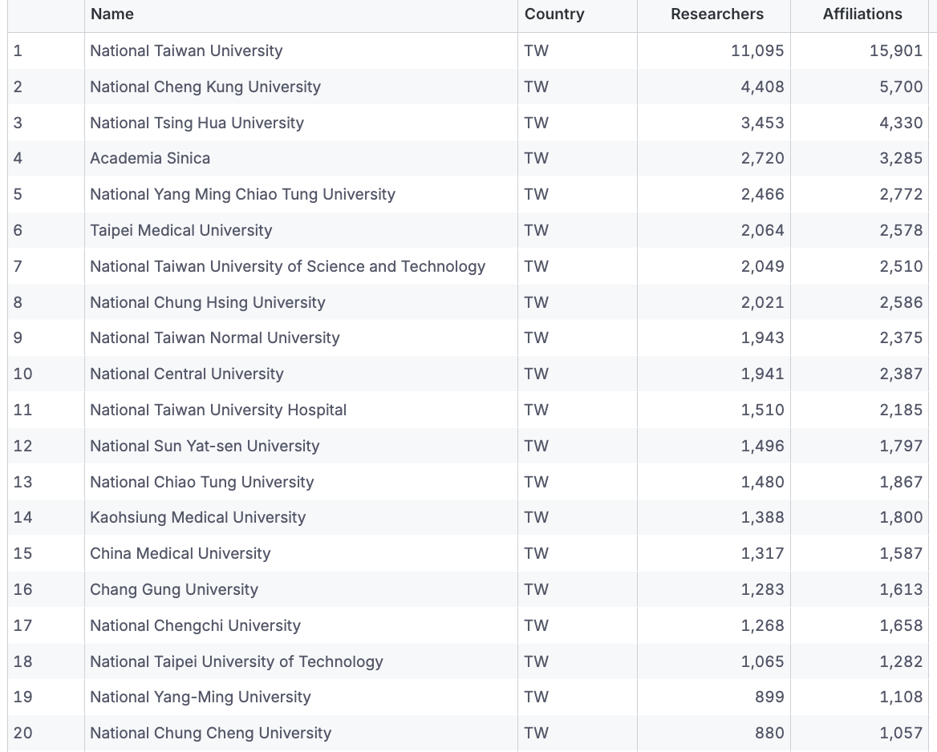
Most represented institutions in the registry

Slide 8
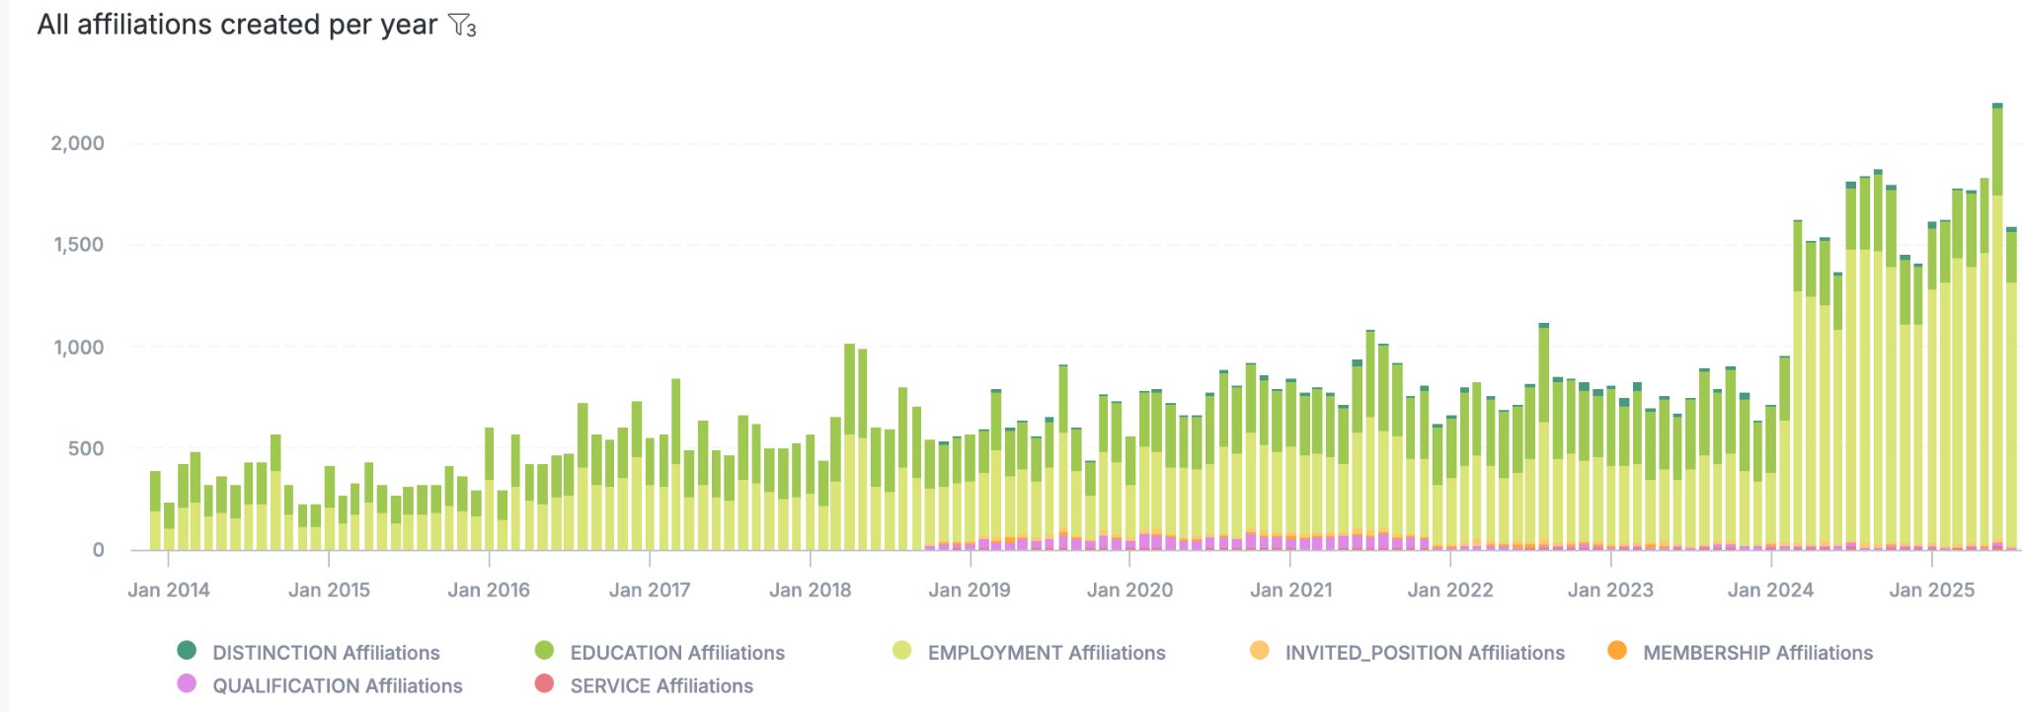
A closer look at the 106.27K affiliations and professional activities

Slide 9
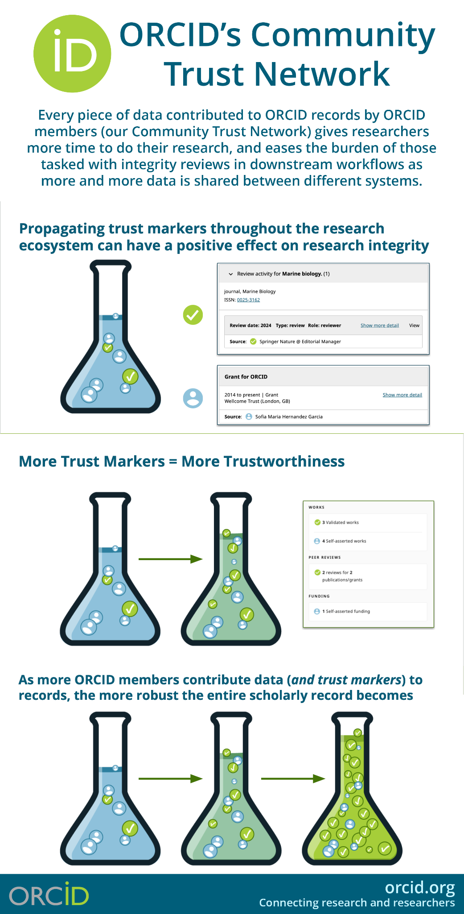
Validating Affiliations to Save Time, Boost Accuracy, and Streamline Workflows
Only 4.75K affiliations, out of the total 106.27K are added by member organizations. That is, 4 % of the data are added by organizations, and the rest 96 % by researchers’ manual entry.
It means researchers spend time doing the data entry - administrative burden.
By adding more validation affiliations, Universities and research institutions in Taiwan can help your researchers and your organizations
  Save time
  Reduce manual burden
  Streamline process

Slide 10



How to integrate? / Three ways of doing it
Use an existing certified service provider (e.g. DSpace-CRIS, Pure, OJS…), (or systems that support ORCID)
Develop a custom integration (for self-developed institutional systems)
Adopt the Affiliation Manager (consortium members only)
Documentation: https://info.orcid.org/documentation/integration-guide/
Certified service providers: https://info.orcid.org/vendors-and-service-providers/orcid-certified-service-providers-list/
Affiliation Manager: https://info.orcid.org/affiliation-manager/

Slide 11
ORCID Certified Service Providers make it easier to adopt ORCID more quickly

Slide 12

















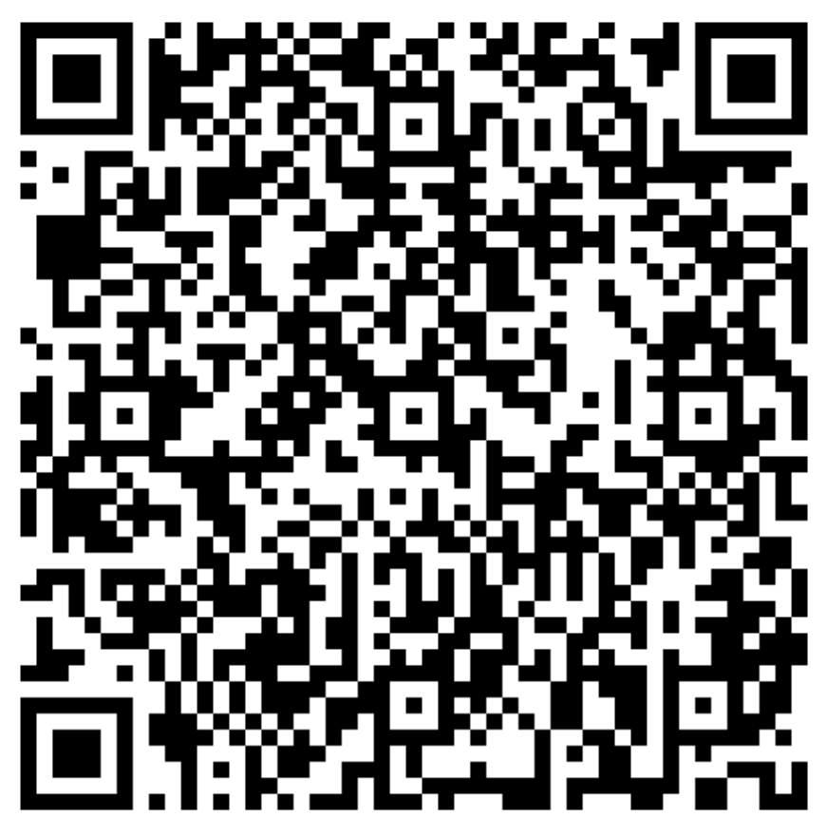
ORCID enables vendors to make it easier for members to expedite the contribution of trusted data
https://info.orcid.org/vendors-and-service-providers/become-an-orcid-certified-service-provider/
ORCID certification criteria for 5 scholarly workflows:
Benefits to organizations using a CSP Out-of-the-box, best-in-class ORCID-related functionality No need for custom technical development A more consistent user experience Training and support support from the vendor
Benefits for vendors offering CSPs Enhanced Promotion from ORCID: Listing on our website Recommendation to members ORCID CSP Badge Certification letter for proposals/tenders Enhanced Support from ORCID Advanced reporting
1. | Manuscript Submission Systems
2. | Research Information Systems
3. | Grant/Facility Application Management Systems
4. | Repository Systems | 5. | Discovery Systems
Notes:
Organizations from all our stakeholder groups use service providers that have pre-built ORCID functionality in their products and services. They enable our members to adopt ORCID, and to start contributing their trusted data, in the quickest, simplest way: by providing a means to easily integrate ORCID into their local workflows and systems and provide a more consistent user experience for researchers when they encounter ORCID. And we certify systems through our Certified Service Provider program which defines specific best practices for different workflows, ensuring that members who use these systems always experience best practice ORCID integrations and can more easily add trusted data to their researchers’ records … We now have 5 specific workflows that can be certified.

Slide 13
Case Studies

Slide 14
Israel: Driving Local Integration and Research Visibility
Established in 2018
🏛️ Lead Organization
Inter-University Computation Center (IUCC) Coordinates technical support and strategic outreach across Israeli universities.
🧩 Membership Overview
8 of 9 Israeli universities included
Acts as a communication bridge to the Israeli funders. Israel Science Foundation (funder) and Binational Agricultural Research Development (BARD)

Slide 15
Israel: Driving Local Integration and Research Visibility
🎯 Strategic Goals
Promote ORCID adoption across academia
Embed ORCID iDs into national research workflows
Impact:
All integrations collect authenticated iDs, push affiliation data and keywords
🏆 Winner of ORCID Excellence Award for integration leadership

Slide 16
Denmark: Over a Decade Advancing Research Integration and Trust
Established in 2014.
🏛️ Lead Organization
Aalborg University (Library) coordinates technical support, strategic outreach and PIDs projects in their research community.
🧩 Membership Overview
Members: 11 institutions
  Universities, hospitals, research centers, and design schools
Shared Infrastructure: All members use Pure (CRIS) for seamless ORCID integration
Hosts annual consortium meetings to drive collaboration and advocacy
Contributes huge amounts of trust markers to ORCID registry

Slide 17


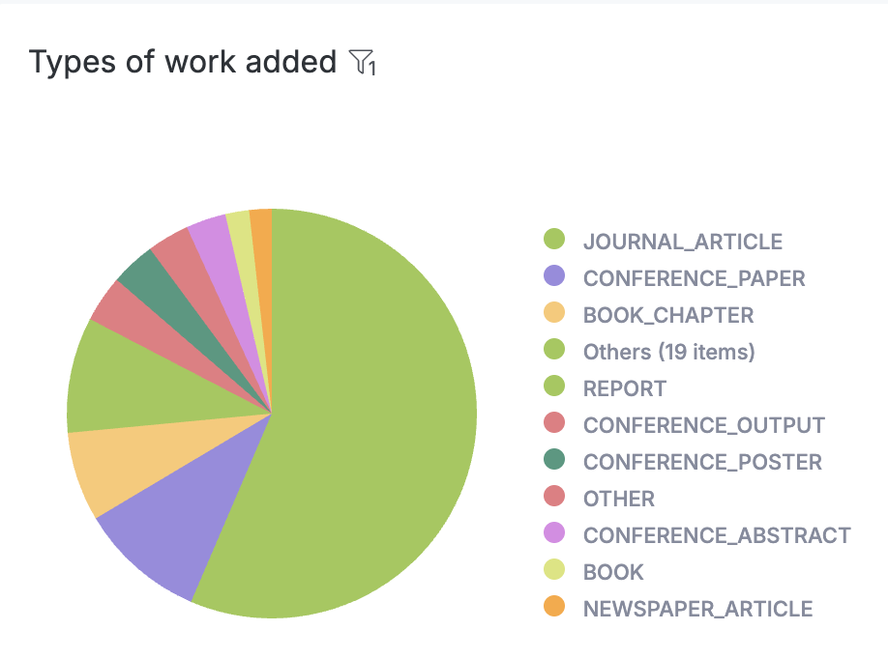
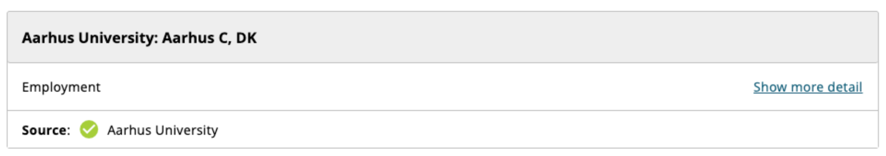
Denmark: Over a Decade Advancing Research Integration and Trust
1.20 million
Works added
1.5 million
Trust makers added by
20
ORCID integrated systems for
27.27K
researchers
28.92K
Affiliations added
Notes:
Aalborg University Library
Contributes huge amounts of data to ORCID registry
1.2 million total works added
16k records updated in 2024
170,900 works added in 2024

Slide 18
Impact is measured by strategy, collaboration, and commitment (not by size!)

Slide 19
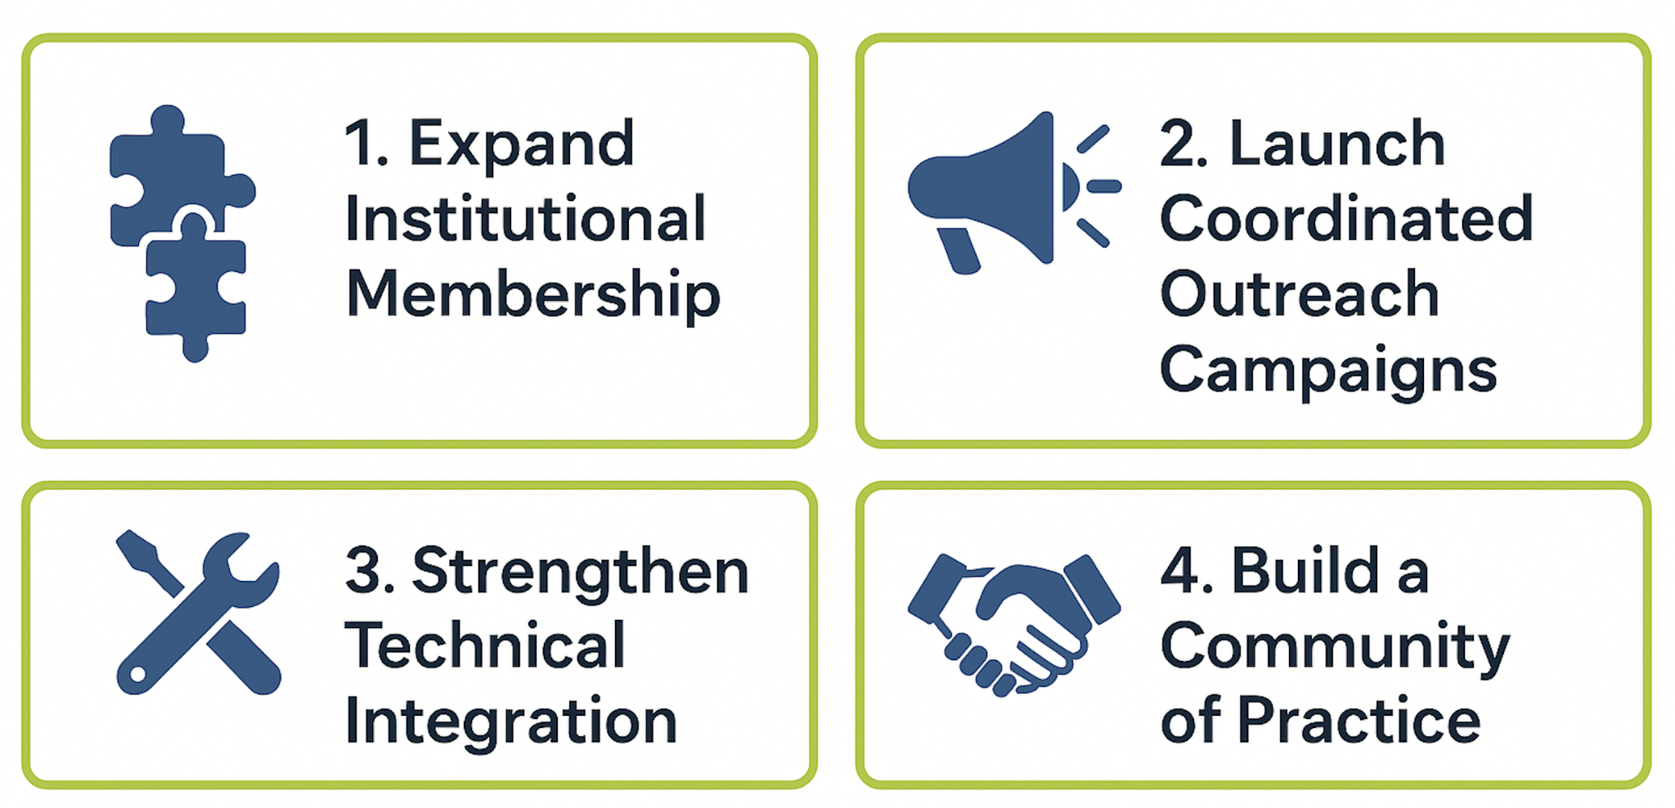
Let’s work together
Strategic Actions for the Research Community in Taiwan:

Slide 20
As a start, let’s
Identify the first step for us to start collaborations
  Set up a regular exchange
  Develop the Taiwan strategy
  Participate in ORCID’s Consortia Interests Group

Slide 21

Thank you!
Find out more at https://orcid.org
Register at https://orcid.org/register
Email - e.cheng@orcid.org
Skype - j493520@hotmail.com
Twitter @ChihEstelle

Slide 22
References links
ORCID membership https://info.orcid.org/membership/
ORCID Consortia
Step-by-step tutorial covering the basics of the API (3-legged-OAuth process, important API Calls) for custom integrations: https://orcid.github.io/orcid-api-tutorial/
ORCID member directory https://orcid.org/members
ORCID Blog https://info.orcid.org/category/blog/
ORCID Statistics https://info.orcid.org/orcid-statistics/
Getting started with your integration https://info.orcid.org/documentation/integration-guide/getting-started-with-your-orcid-integration/
ORCID workflows https://info.orcid.org/documentation/workflows/
ORCID member reporting https://info.orcid.org/documentation/features/member-reporting/

Slide 23


Discussion and Feedback

Slide 24
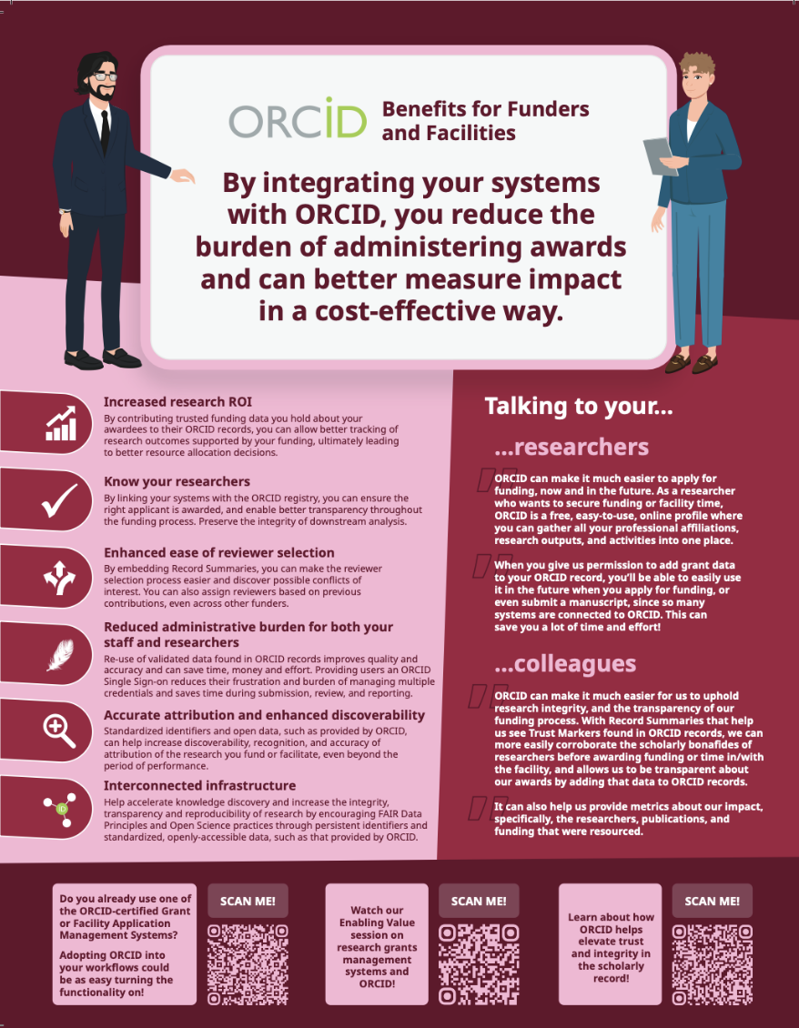
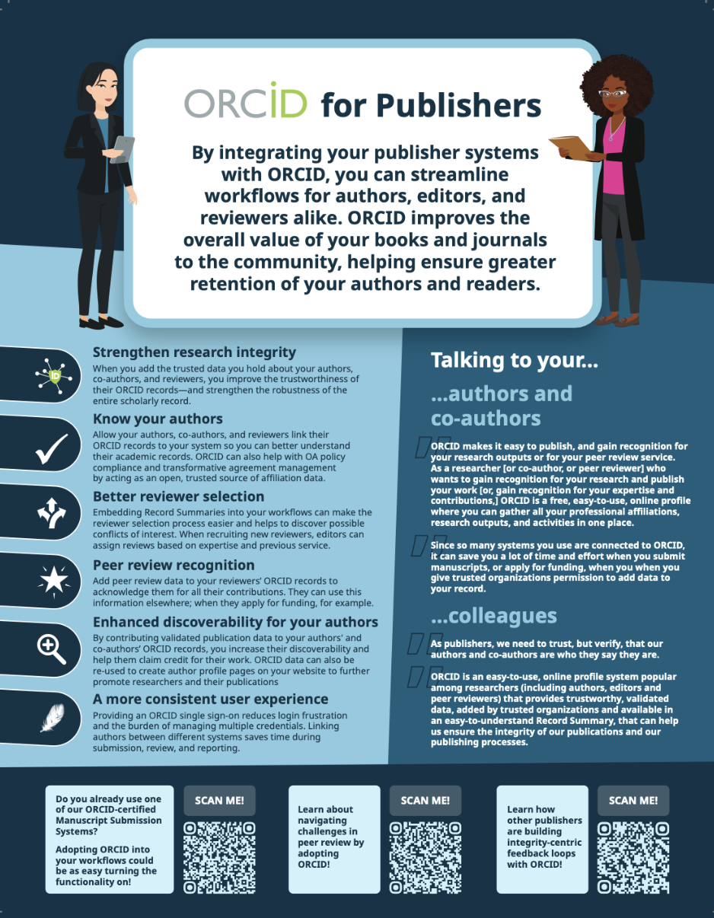
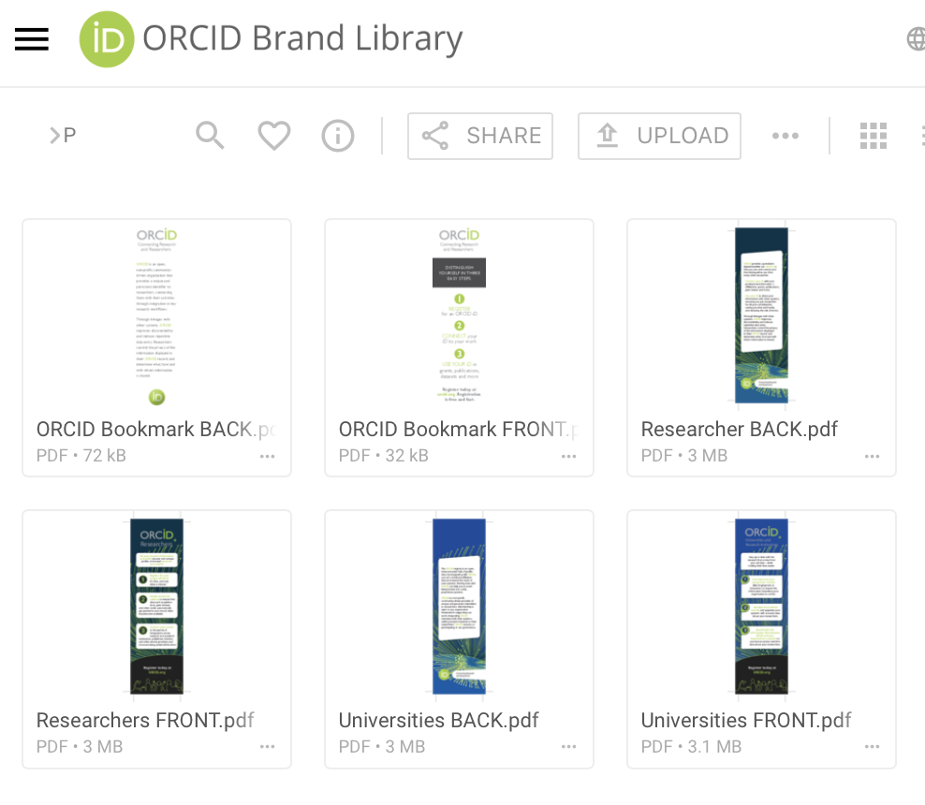
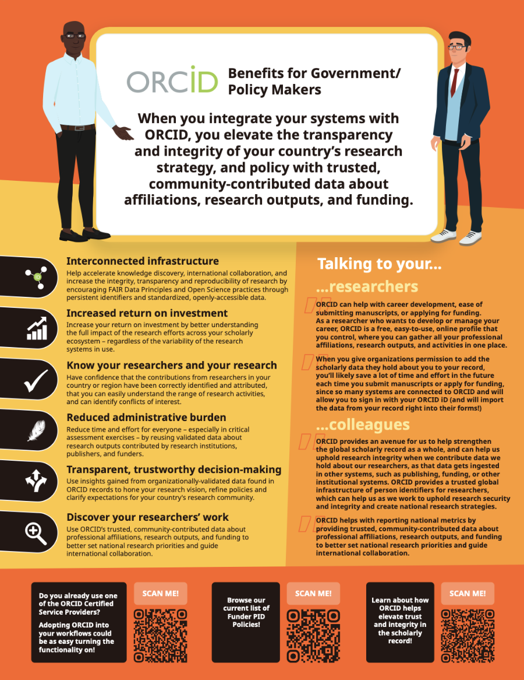
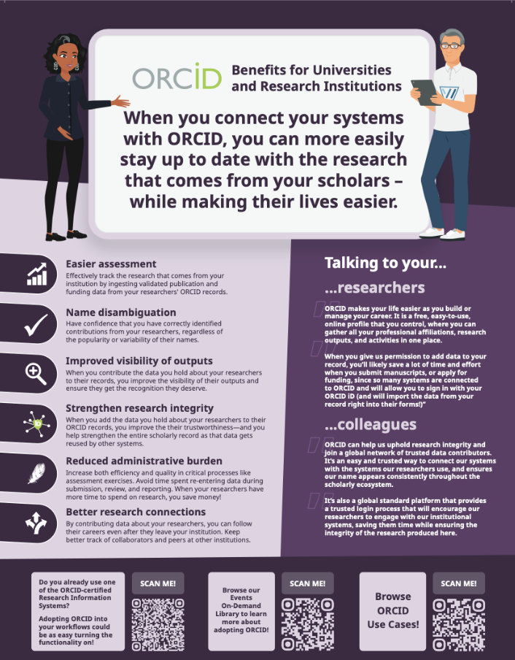
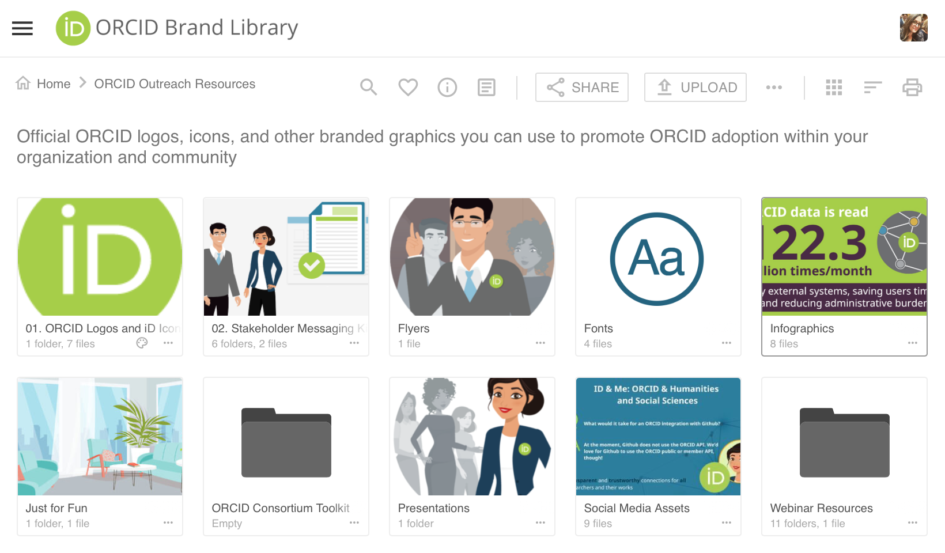
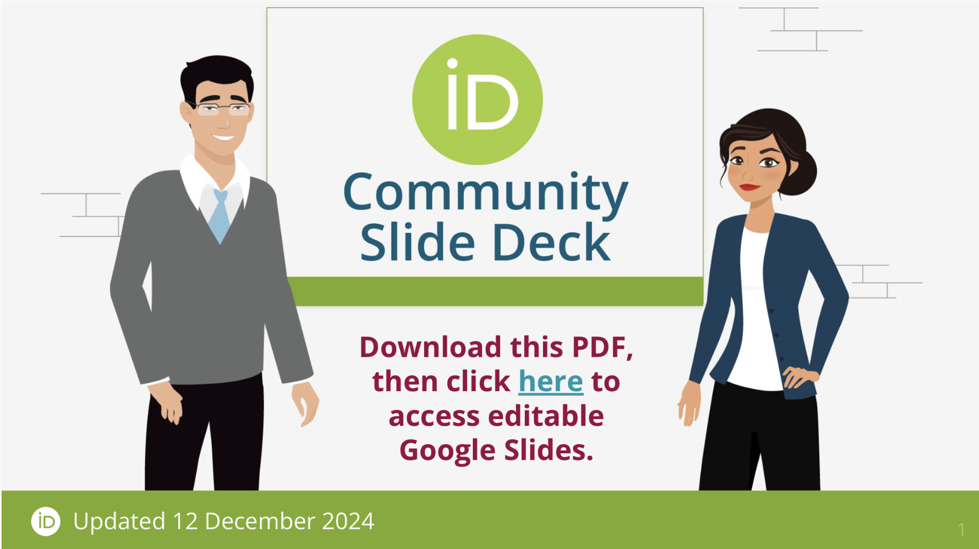
We have resources available to members to advocate for ORCID
ORCID’s Brand Library
Notes:
Outreach materials with Community Trust Network and Trust Marker messaging is available in our Brand Library. We have a Slide Deck you can customize to fit your presentation needs, we have fliers, graphics, and other useful things there too that can help as you promote ORCID adoption at your organization or among your colleagues.

